Slide 1
Optimization for ML (contd.)
CS771: Introduction to Machine Learning
Nisheeth

Slide 2
Announcements
Quiz 1 pro-rate policy
I will pro-rate marks for those who were able to attempt more than 15 marks worth of problems in Quiz 1 based on Quiz 1 mark percentiles (assumption: people would have performed at the same percentile of the class for unseen problems as seen problems)
I will pro-rate marks for those who were able to attempt less than or equal to 15 marks worth of problems in Quiz 1 based on Mid Sem exam percentiles
If anyone has an objection to this policy, please let me know ASAP
Quiz 1 is graded; marks will show up on HelloIITK soon
8 people scored full marks, suggesting the paper was not that hard
Mid Sem exam is on 12th Sept
We will follow the same pattern as Quiz 1: real-time exam followed by a take-home assignment
Syllabus will include everything covered till 10th Sept
Today: more optimization (reference material: Chapter 7 of this book)

Slide 3
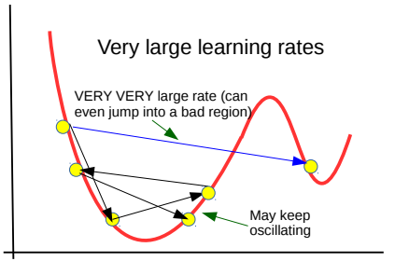
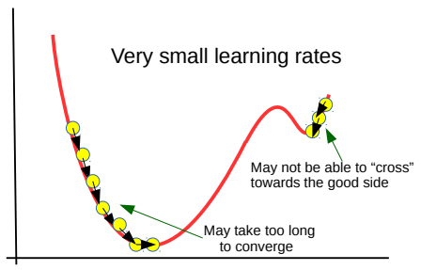

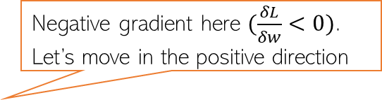











Recall: Gradient Descent
Negative gradient here $(\frac{δL}{δw}<0)$. Let’s move in the positive direction
Learning rate is very important
$$L(w)$$
Positive gradient here. Let’s move in the negative direction
$$w^{(2)}$$
$$w_{∗}$$
$$w^{(1)}$$
$$w^{(0)}$$
$$w$$
$$w^{(0)}$$
$$w^{(1)}$$
$$w^{(3)}$$
$$w^{(2)}$$
$$w^{(3)}$$
$$w_{∗}$$
Woohoo! ☺ Global minima found!!!
Stuck at a local minima ☹
GD thanks you for the good initialization ☺
Good initialization is very important

Slide 4

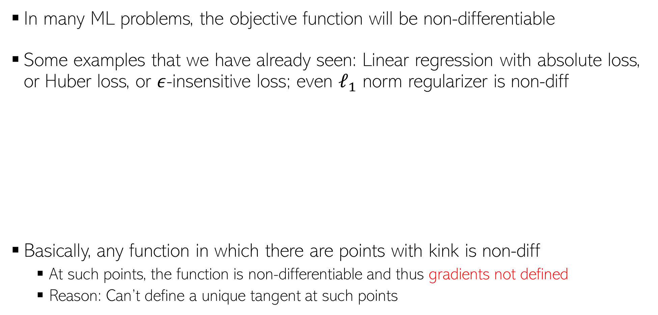








Dealing with Non-differentiable Functions
In many ML problems, the objective function will be non-differentiable
Some examples that we have already seen: Linear regression with absolute loss, or Huber loss, or $ε$-insensitive loss; even $ℓ_{1}$ norm regularizer is non-diff
Basically, any function in which there are points with kink is non-diff
At such points, the function is non-differentiable and thus gradients not defined
Reason: Can’t define a unique tangent at such points
Loss
$${|y}_{n}−f\left(x_{n}\right)|−ε$$
Loss
$${|y}_{n}−f\left(x_{n}\right)|$$
Loss
Not diff. here
Not diff. here
${y_{n}− f(x}_{n}$)
$$−δ$$
$$δ$$
${y_{n}− f(x}_{n}$)
$$−ε$$
$$ε$$
${y_{n}− f(x}_{n}$)
Not diff. here
Not diff. here
Not diff. here

Slide 5
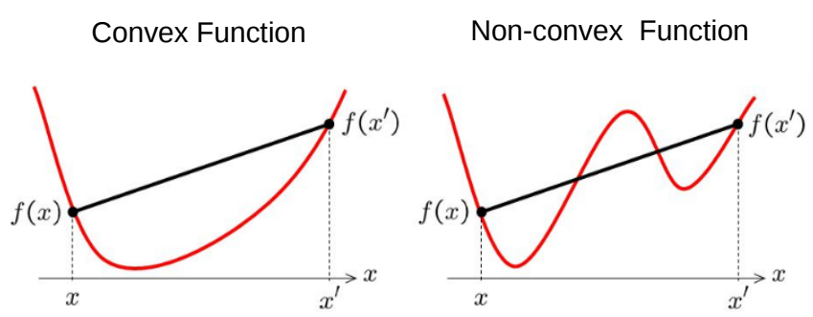
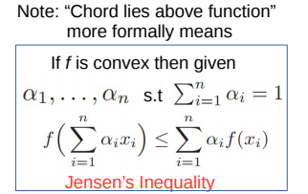
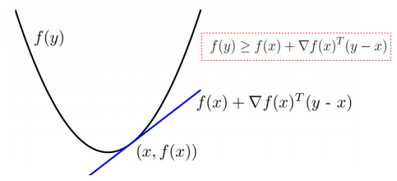

Recall: Convex Functions
Informally, $f(x)$ is convex if all of its chords lie above the function everywhere
Formally, (assuming differentiable function), some tests for convexity:
First-order convexity (graph of $f$ must be above all the tangents)
Second derivative a.k.a. Hessian (if exists) must be positive semi-definite

Slide 6


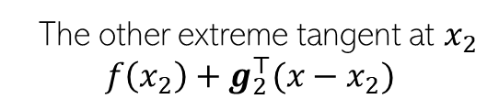
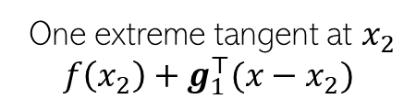


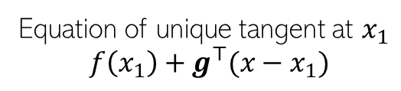
Sub-gradients
For convex non-diff fn, can define sub-gradients at point(s) of non-differentiabilty
For a convex, non-diff function $f(x)$, sub-gradient at$x_{∗}$is any vector $g$ s.t. $∀x$
$$f\left(x\right)$$
Convex, thus lies above all its tangents
Equation of unique tangent at $x_{1}$
$$f\left(x_{1}\right)+g^{⊤}(x−x_{1})$$
differentiable
here
One extreme tangent at $x_{2}$
$$f\left(x_{2}\right)+g_{1}^{⊤}(x−x_{2})$$
non-differentiable
here
Region containing all sub-gradients
The other extreme tangent at $x_{2}$
$$f\left(x_{2}\right)+g_{2}^{⊤}(x−x_{2})$$
$$x_{1}$$
$$x_{2}$$
$$f\left(x\right)≥f\left(x_{∗}\right)+ g^{⊤}(x−x_{∗})$$

Slide 7
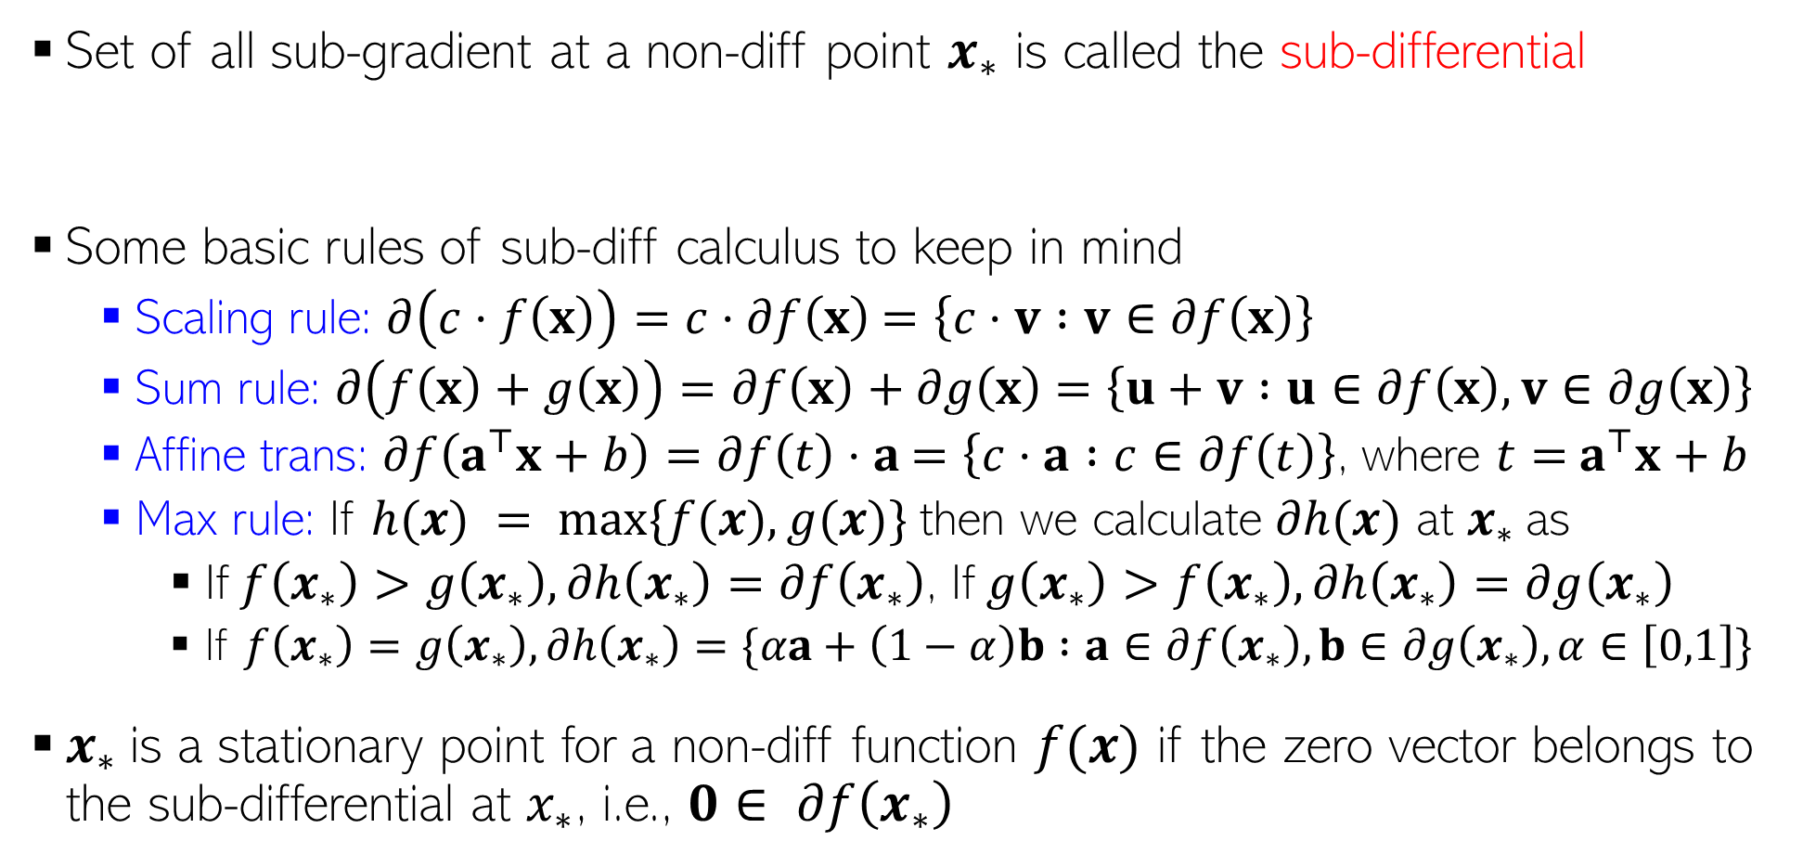
Sub-gradients, Sub-differential, and Some Rules
Set of all sub-gradient at a non-diff point $x_{∗}$ is called the sub-differential
Some basic rules of sub-diff calculus to keep in mind
Scaling rule: $∂\left(c⋅f\left(x\right)\right)=c⋅∂f\left(x\right)$ $=\left\{c⋅v :v∈∂f\left(x\right)\right\}$
Sum rule: $∂\left(f\left(x\right)+g\left(x\right)\right)=∂f\left(x\right)+∂g\left(x\right)$ $=\left\{u+v :u∈∂f\left(x\right),v∈∂g\left(x\right)\right\}$
Affine trans: $∂f\left(a^{⊤}x+b\right)=∂f\left(t\right)⋅a$ $=\left\{c⋅a :c∈∂f\left(t\right)\right\}$, where $t=$ $a^{⊤}x+b$
Max rule: If $h(x) = max⁡\{f(x),g(x)\}$then we calculate $∂h(x)$ at $x_{∗}$as
If $f\left(x_{∗}\right)>g\left(x_{∗}\right),∂h\left(x_{∗}\right)=∂f\left(x_{∗}\right)$, If $g\left(x_{∗}\right)>f\left(x_{∗}\right),∂h\left(x_{∗}\right)=∂g\left(x_{∗}\right)$
If $f\left(x_{∗}\right)=g\left(x_{∗}\right), ∂h\left(x_{∗}\right)=\{αa+\left(1−α\right)b :a∈∂f\left(x_{∗}\right),b∈∂g\left(x_{∗}\right),α∈\left[0,1\right]\}$
$x_{∗}$is a stationary point for a non-diff function $f(x)$ if the zero vector belongs to the sub-differential at $x_{∗}$, i.e., $0∈ ∂f\left(x_{∗}\right)$
$$∂f\left(x_{∗}\right)≜\left\{g :f\left(x\right)≥{f\left(x_{∗}\right)+g}^{⊤}\left(x−x_{∗}\right) ∀x\right\}$$
The affine transform rule is a special case of the more general chain rule

Slide 8

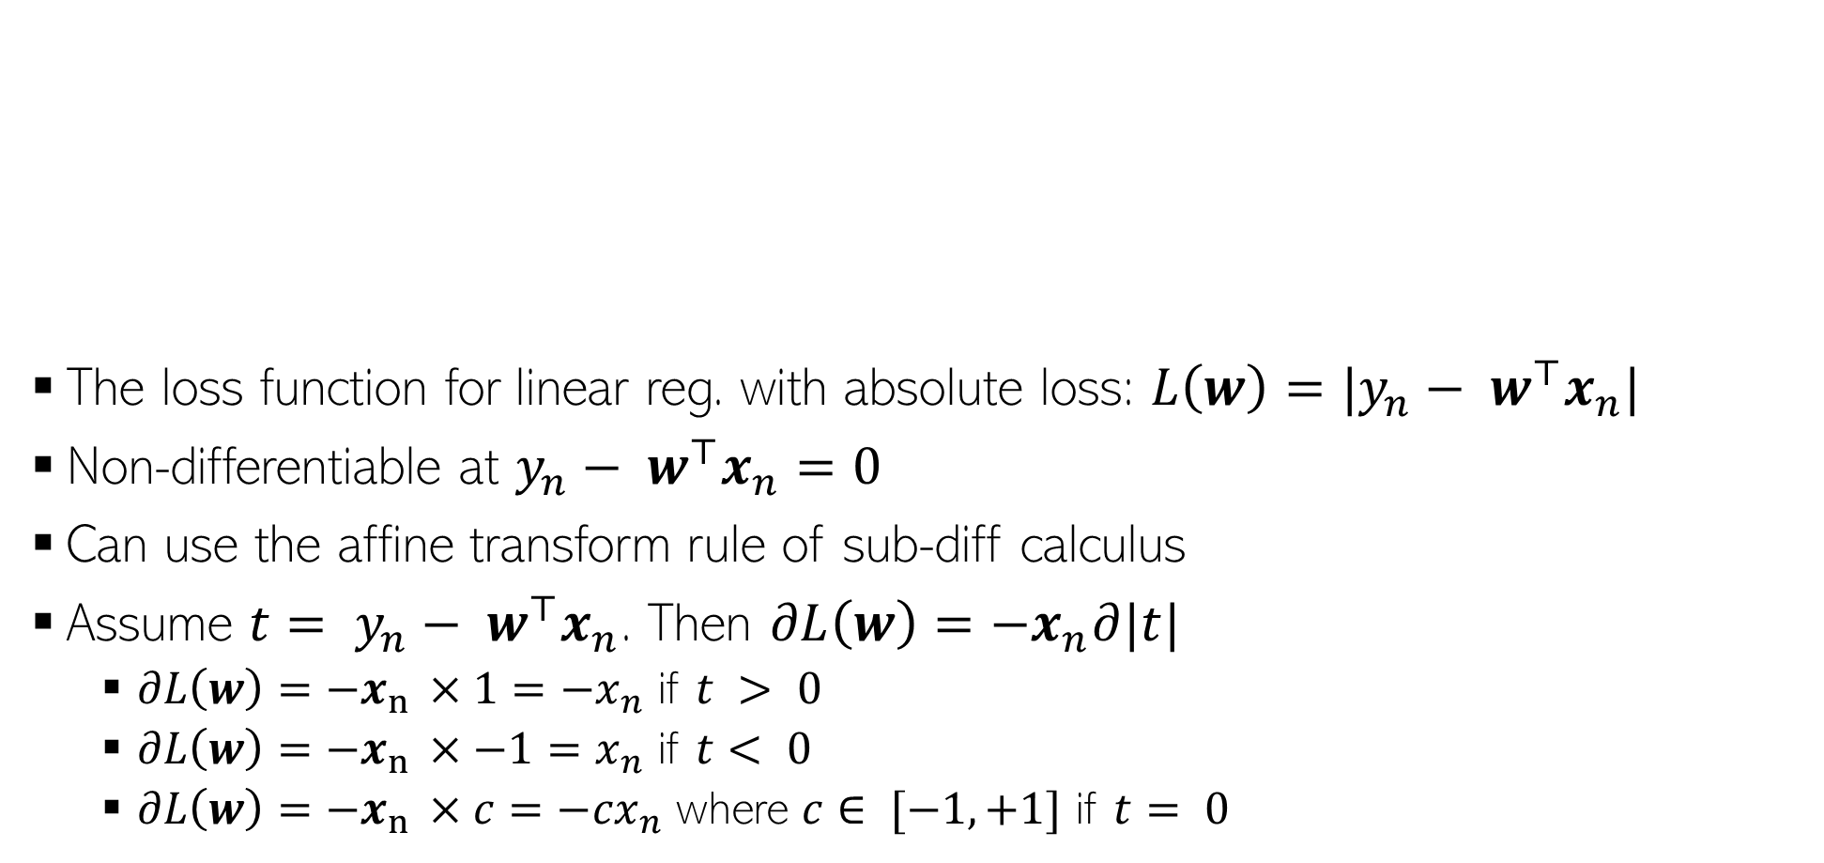



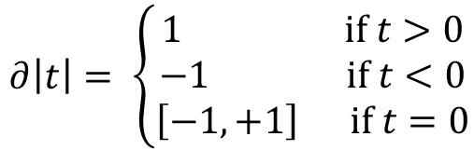


Sub-Gradient For Absolute Loss Regression
$$|y_{n}− w^{⊤}x_{n}|$$
The loss function for linear reg. with absolute loss: $L\left(w\right)=|y_{n}− w^{⊤}x_{n}|$
Non-differentiable at $y_{n}− w^{⊤}x_{n}=0$
Can use the affine transform rule of sub-diff calculus
Assume ${t= y}_{n}− w^{⊤}x_{n}$. Then $∂L\left(w\right)=−x_{n}∂|t|$
$∂L\left(w\right)=−x_{n }×1=−x_{n}$ if $t > 0$
$∂L\left(w\right)=−x_{n }×−1=x_{n}$ if $t< 0$
$∂L\left(w\right)=−x_{n }×c=−{cx}_{n}$ where $c∈ [−1,+1]$ if $t= 0$
$$|t|$$
$∂\left|t\right|= \left\{\begin{aligned}1 if t>0 \\ −1 if t<0 \\ \left[−1,+1\right] if t=0\end{aligned}\right.$
$$0$$
$$y_{n}− w^{⊤}x_{n}$$
$$0$$
$$t$$

Slide 9



Sub-Gradient Descent
Suppose we have a non-differentiable function $L(w)$
Sub-gradient descent is almost identical to GD except we use subgradients
Sub-Gradient Descent
Initialize $w$ as $w^{(0)}$
For iteration $t=0,1,2,…$(or until convergence)
Calculate the sub-gradient $g^{(t)}∈∂L(w^{(t)})$
Set the learning rate $η_{t}$
Move in the opposite direction of subgradient
$$w^{(t+1)}= w^{(t)}−η_{t}g^{(t)}$$

Slide 10

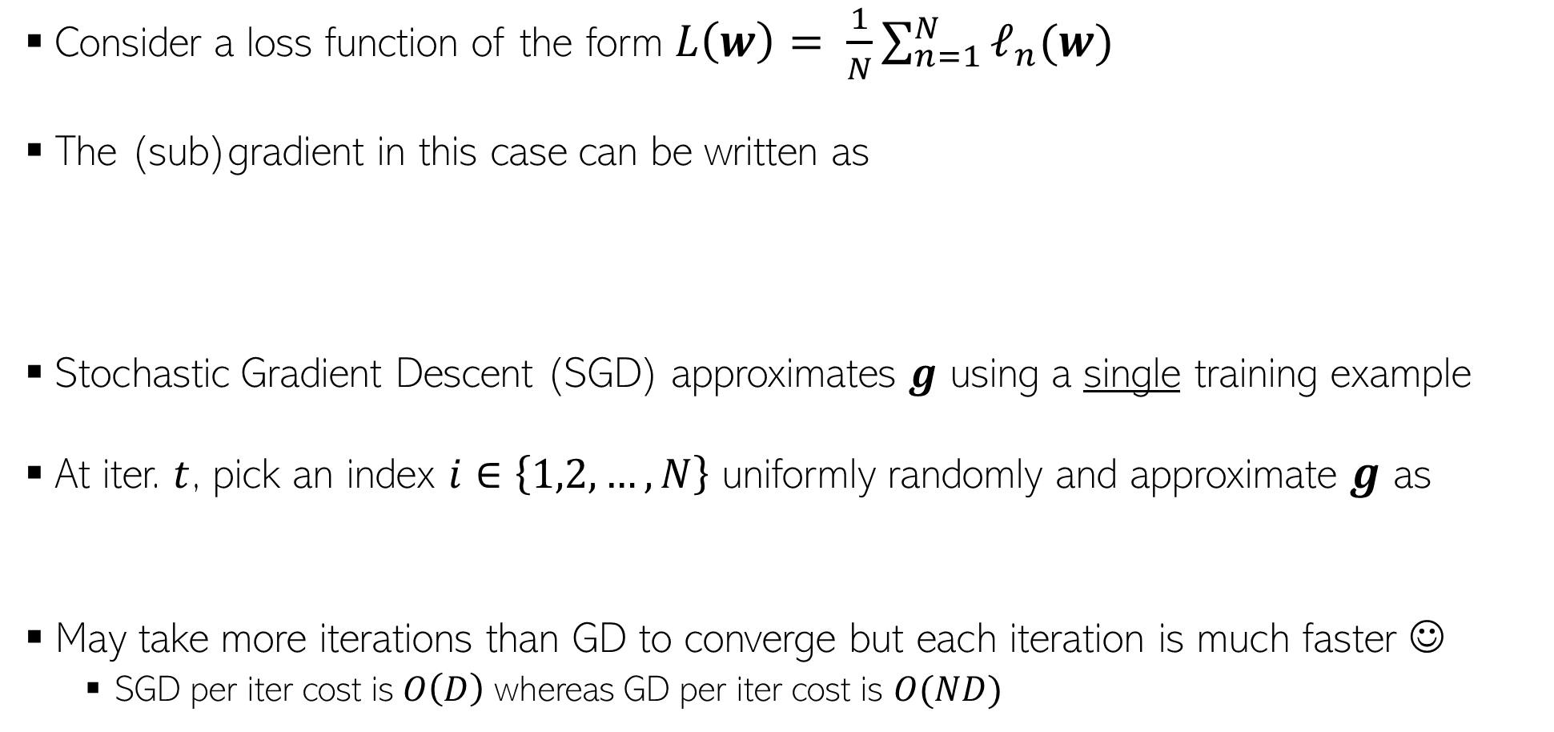

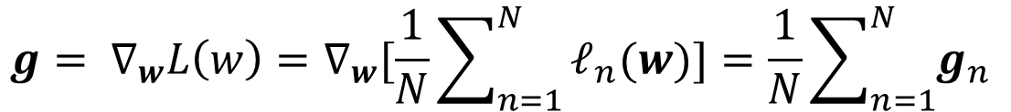
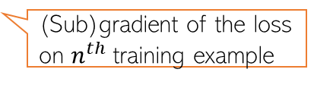
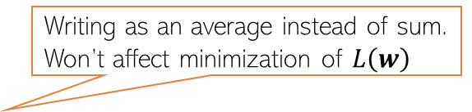

Stochastic Gradient Descent (SGD)
Writing as an average instead of sum. Won’t affect minimization of $L\left(w\right)$
Consider a loss function of the form $L\left(w\right)= \frac{1}{N}\sum_{n=1}^{N}{ℓ_{n}(w)}$
The (sub)gradient in this case can be written as
Stochastic Gradient Descent (SGD) approximates $g$ using a single training example
At iter. $t$, pick an index $i∈\left\{1,2,…,N\right\}$ uniformly randomly and approximate $g$ as
May take more iterations than GD to converge but each iteration is much faster ☺
SGD per iter cost is$O\left(D\right)$ whereas GD per iter cost is $O(ND)$
Expensive to compute – requires doing it for all the training examples in each iteration
$${g= ∇}_{w}L\left(w\right)=∇_{w}[\frac{1}{N}\sum_{n=1}^{N}{ℓ_{n}(w)]=\frac{1}{N}\sum_{n=1}^{N}{g_{n} }}$$
(Sub)gradient of the loss on $n^{th}$training example
Can show that $g_{i}$ is an unbiased estimate of $g$, i.e.,$𝔼\left[g_{i}\right]=g$
$$g≈g_{i}=∇_{w}ℓ_{i}(w)$$

Slide 11
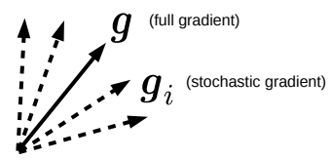
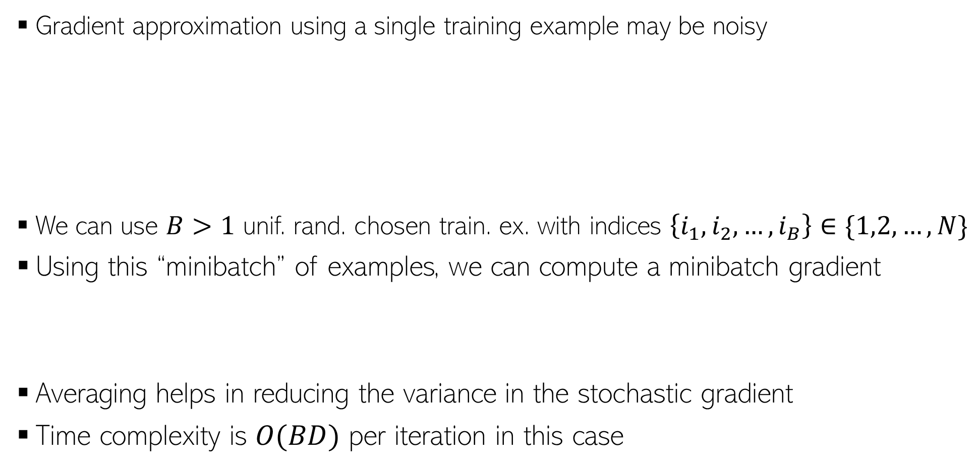

Minibatch SGD
Gradient approximation using a single training example may be noisy
We can use $B>1$ unif. rand. chosen train. ex. with indices $\left\{i_{1},i_{2},…,i_{B}\right\}∈\{1,2,…,N\}$
Using this “minibatch” of examples, we can compute a minibatch gradient
Averaging helps in reducing the variance in the stochastic gradient
Time complexity is $O(BD)$ per iteration in this case
The approximation may have a high variance – may slow down convergence, updates may be unstable, and may even give sub-optimal solutions (e.g., local minima where GD might have given global minima)
$$g≈\frac{1}{B}\sum_{b=1}^{B}{g_{i_{b}}}$$

Slide 12
Constrained Optimization

Slide 13


Projected Gradient Descent
Consider an optimization problem of the form
Projected GD is very similar to GD with an extra projection step
Each iteration $t$ will be of the form
Perform update: $z^{(t+1)}= w^{(t)}−η_{t}g^{(t)}$
Check if $z^{(t+1)}$ satisfies constraints
If $z^{(t+1)}∈𝒞,$set $w^{(t+1)}$= $z^{(t+1)}$
If $z^{(t+1)}∉𝒞,$ project as $w^{(t+1)}$= $Π_{𝒞}[z^{(t+1)}]$
$w_{opt}= {arg min}_{w∈𝒞}$ $L(w)$
Projection
step
Projection operator

Slide 14
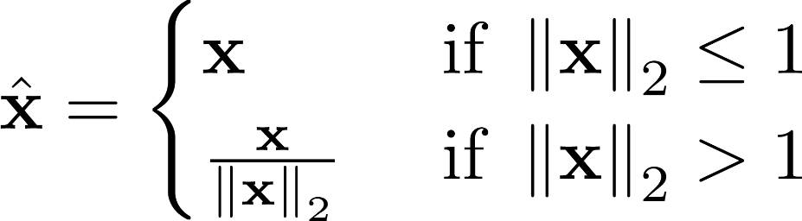
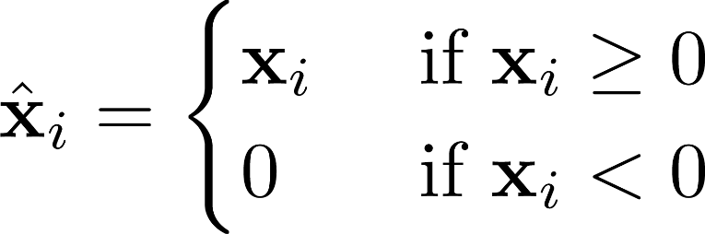



Projected GD: How to Project?
Here projecting a point means finding the “closest” point from the constraint set
For some sets $𝒞$, the projection step is easy
$Π_{𝒞}\left[z\right]={arg min}_{w∈𝒞}$ ${\left\|z−w\right\|}^{2}$
Projected GD commonly used only when the projection step is simple and efficient to compute
$𝒞$: Unit radius $ℓ_{2}$ball
$𝒞$: Set of non-negative reals
(0,1)
(1,0)
Projection = Normalize to unit Euclidean length vector
Projection = Set each negative entry in $z$ to be zero

Slide 15
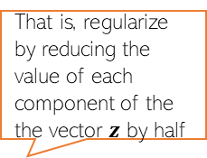

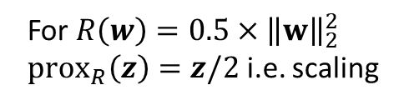

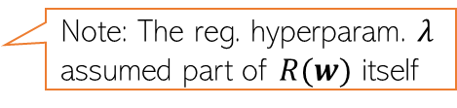

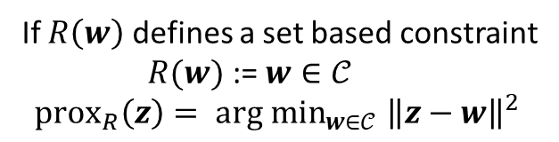
Proximal Gradient Descent
Consider minimizing a regularized loss function of the form
Proximal GD popular when regularizer $R(w)$ is non-differentiable
Basic idea: Do GD on $L(w)$ and use a prox. operator to regularize via $R(w)$
For a func. $R$, its prox. operator is ${prox}_{R}\left(z\right)=\arg{\min_{w}\left[R\left(w\right)+\frac{1}{2}{\left\|z−w\right\|}_{2}^{2}\right]}$
${arg min}_{w} L(w) + R(w)$
Note: The reg. hyperparam. $λ$ assumed part of $R(w)$ itself
Proximal GD
Special Cases
That is, regularize by reducing the value of each component of the the vector $z$ by half
Assume reg. loss function of the form $L(w) + R(w)$
Initialize $w$ as $w^{(0)}$
For iteration $t=0,1,2,…$(or until convergence)
Calculate the (sub)gradient of train. Loss (w/o reg.)
$g^{(t)}∈∂L\left(w^{\left(t\right)}\right)$
Set learning rate $η_{t}$
Step 1: $z^{(t+1)}= w^{(t)}−η_{t}g^{(t)}$
Step 2: $w^{(t+1)}={prox}_{R}\left(z^{(t+1)}\right)$
For $R\left(w\right)=0.5×{\left\|w\right\|}_{2}^{2}$
$prox_{R}\left(z\right)=z/2$ i.e. scaling
If $R\left(w\right)$ defines a set based constraint
$R(w)$ := $w∈𝒞$
$$prox_{R}\left(z\right)= {arg min}_{w∈𝒞} {\left\|z−w\right\|}^{2}$$
Prox. GD becomes equivalent to projected GD

Slide 16


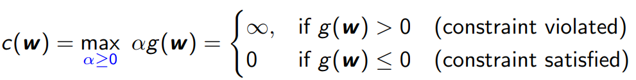
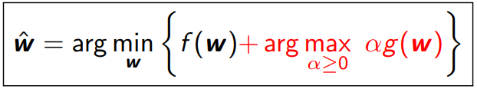
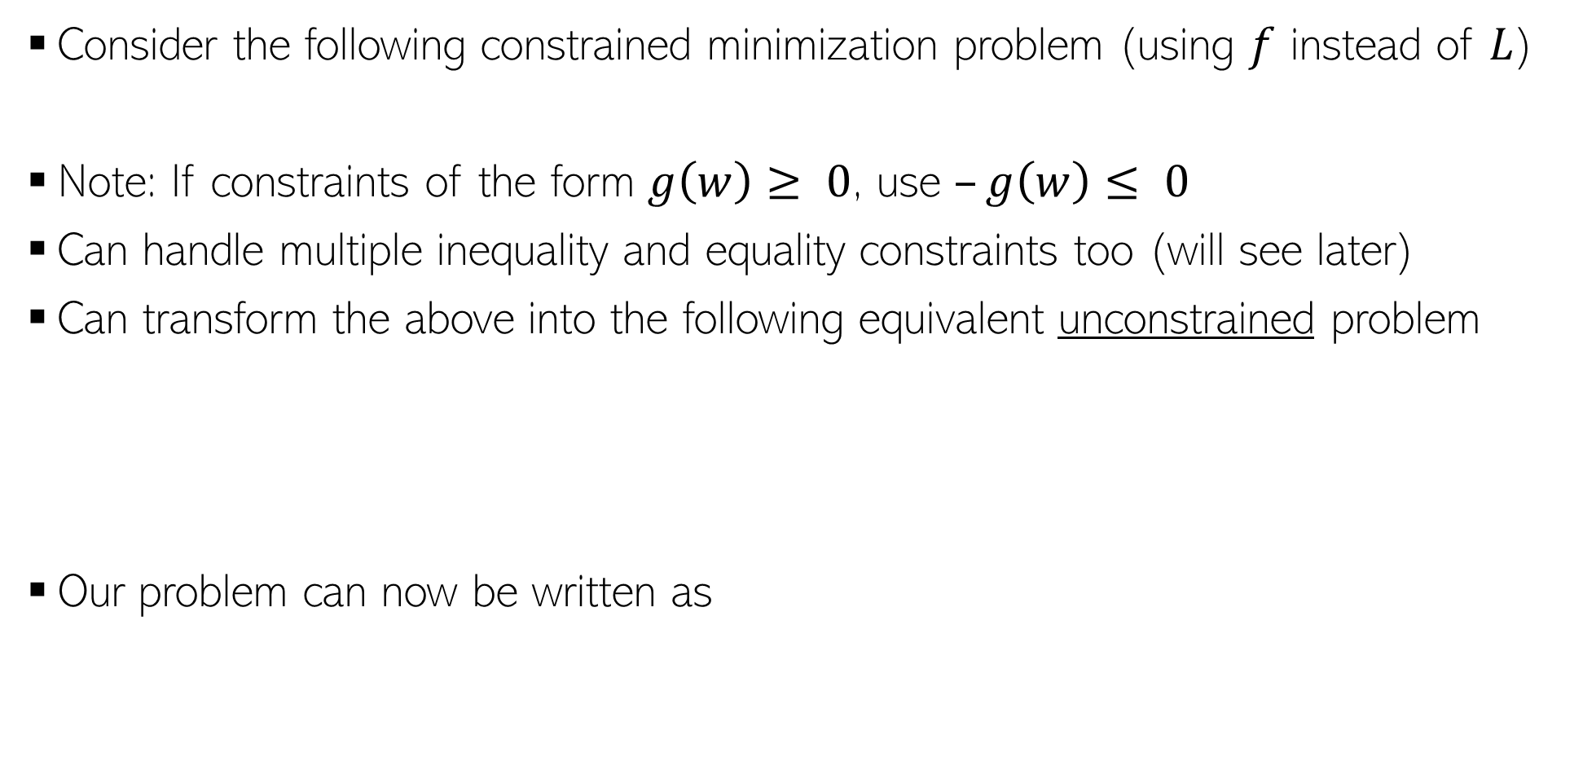
Constrained Opt. via Lagrangian
Consider the following constrained minimization problem (using $f$ instead of $L$)
Note: If constraints of the form $g\left(w\right)≥ 0$, use $–g\left(w\right)≤ 0$
Can handle multiple inequality and equality constraints too (will see later)
Can transform the above into the following equivalent unconstrained problem
Our problem can now be written as

Slide 17
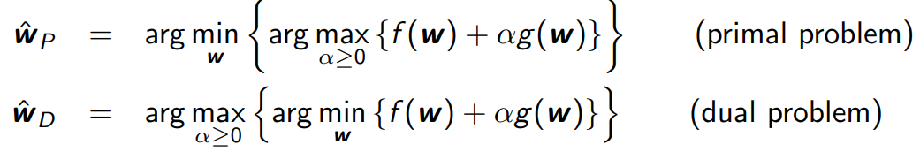

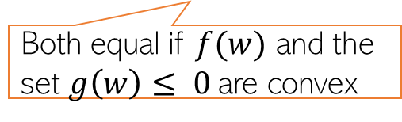
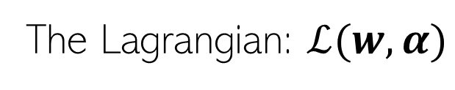
Constrained Opt. via Lagrangian
The Lagrangian: $ℒ(w,α)$
Therefore, we can write our original problem as
The Lagrangian is now optimized w.r.t. $w$ and $α$ (Lagrange multiplier)
We can defined Primal and Dual problem as
Both equal if $f(w)$ and the set $g\left(w\right)≤ 0$are convex

Slide 18
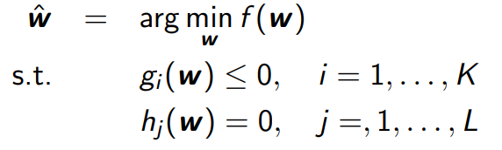
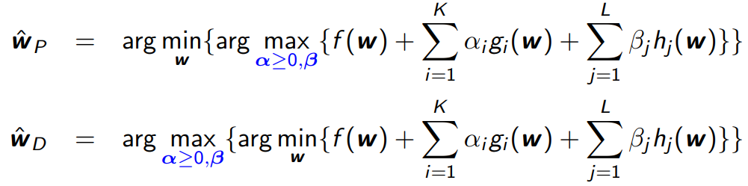

Constrained Opt. with Multiple Constraints
We can also have multiple inequality and equality constraints
Introduce Lagrange multipliers $α=[α_{1},α_{2},…,α_{K}]$ and $β=\left[β_{1},β_{2},…,β_{L}\right]$
The Lagrangian based primal and dual problems will be

Slide 19
Some other useful optimization methods

Slide 20
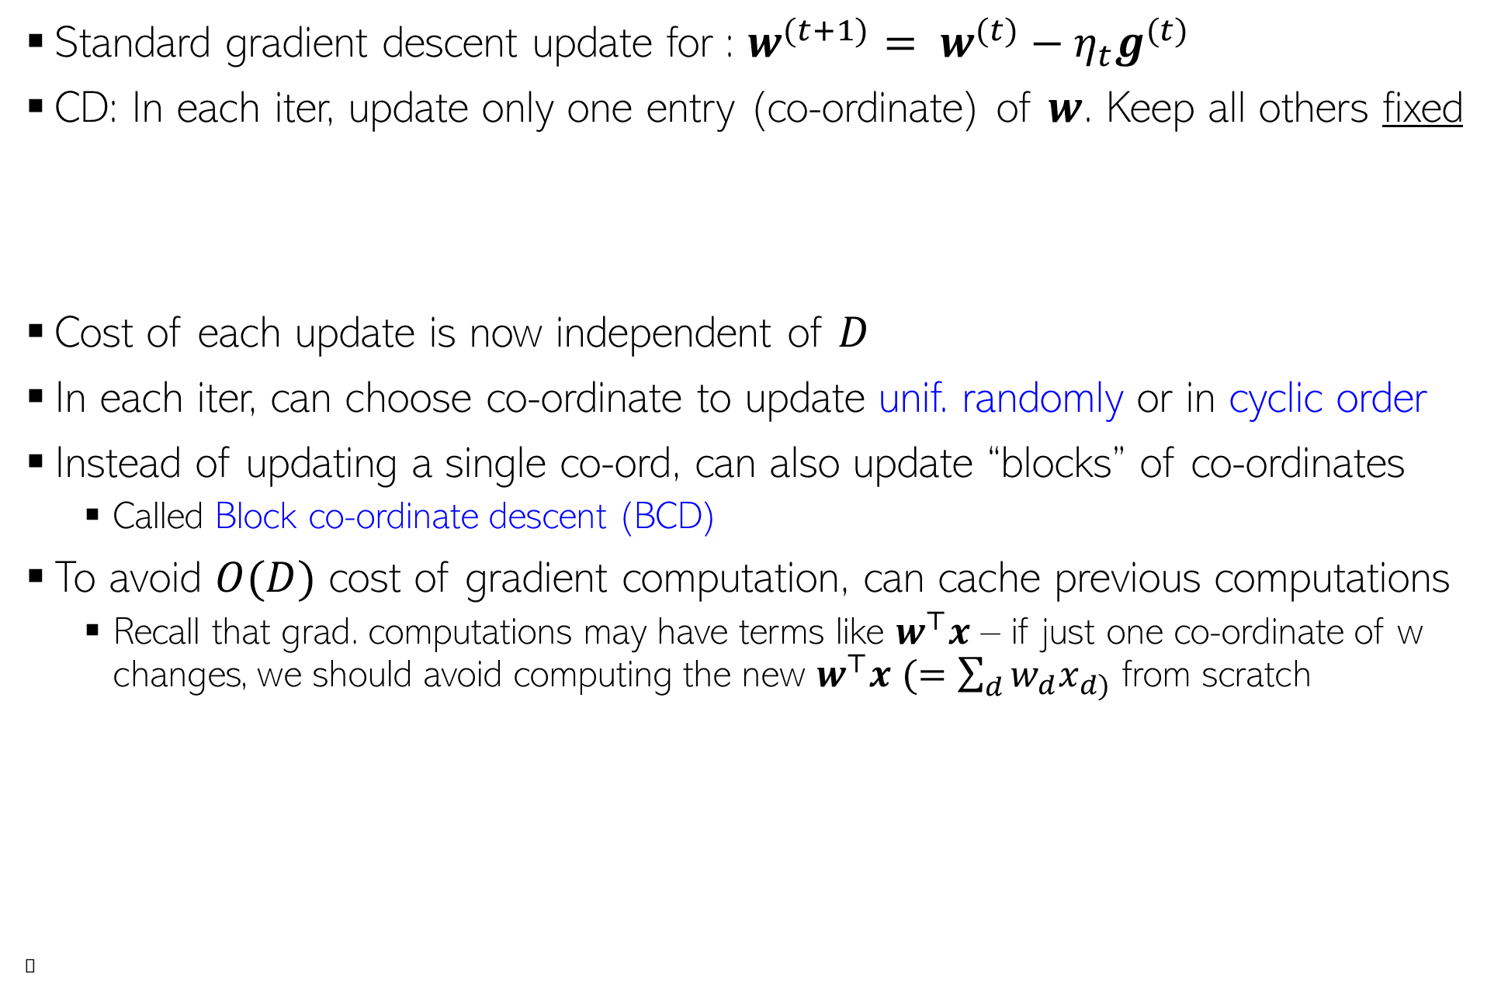
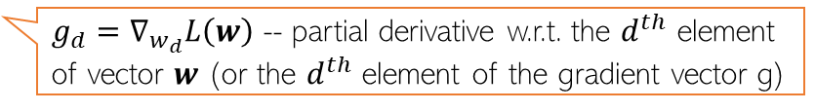
Co-ordinate Descent (CD)
Standard gradient descent update for : $w^{(t+1)}= w^{(t)}−η_{t}g^{(t)}$
CD: In each iter, update only one entry (co-ordinate) of $w$. Keep all others fixed
Cost of each update is now independent of $D$
In each iter, can choose co-ordinate to update unif. randomly or in cyclic order
Instead of updating a single co-ord, can also update “blocks” of co-ordinates
Called Block co-ordinate descent (BCD)
To avoid $O(D)$ cost of gradient computation, can cache previous computations
Recall that grad. computations may have terms like $w^{⊤}x$ – if just one co-ordinate of w changes, we should avoid computing the new $w^{⊤}x$ $(=\sum_{d}{w_{d}x_{d)}}$ from scratch
Ⓣ
$w_{d}^{(t+1)}= w_{d}^{(t)}−η_{t}g_{d}^{(t)}$ $d∈\{1,2,…,D\}$
$g_{d}=∇_{w_{d}}L\left(w\right)$ -- partial derivative w.r.t. the $d^{th}$ element of vector $w$ (or the $d^{th}$ element of the gradient vector g)
=

Slide 21

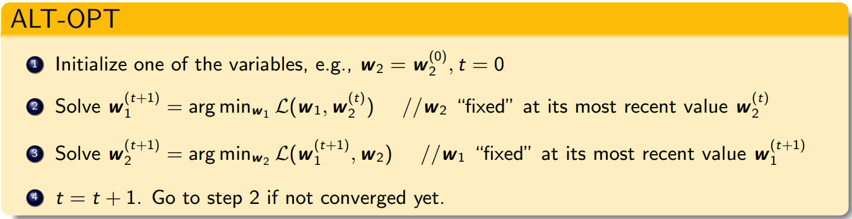

Alternating Optimization (ALT-OPT)
Consider opt. problems with several variables, say two variables $w_{1}$ and $w_{2}$
Often, this “joint” optimization is hard/impossible to solve
We can take an alternating optimization approach to solve such problems
Usually converges to a local optima. But very very useful. Will see examples later
Also related to the Expectation-Maximization (EM) algorithm which we will see later

Slide 22

Some Practical Aspects: Initialization
Iterative opt. algos like GD, SGD, etc need to be initialized to “good” values
Bad initialization can result on bad local optima
Mainly a concern for non-convex loss functions, not so much for convex loss functions
Transfer Learning: Initialize using params of a model trained on a related dataset
Initialize using solution of a simpler but related model
E.g., for multitask regression (say $T$ coupled regression problems), initialize using the solutions of the $T$ independently trained regression problems
For deep learning models, initialization is very important
Transfer learning approach is often used (initialize using “pre-trained” model from another dataset)
Bad initialization can make the model be stuck at saddle points. Need more care.
Random restarts: Running with several random initializations can often help

Slide 23





Some Practical Aspects: Assessing Convergence
Various ways to assess convergence, e.g. consider converged if
The objective’s value (on train set) ceases to change much across iterations
The parameter values cease to change much across iterations
Above condition is also equivalent to saying that the gradients are close to zero
The objective’s value has become small enough that we are happy with
Use a validation set to assess if the model’s performance is acceptable (early stopping)
$L(w^{(t+1)}$) - $L\left(w^{\left(t\right)}\right)<ε$
(for some small pre-defined $ε$)
$\left\|{ w}^{(t+1)} −{ w}^{(t)}\right\|<τ$
(for some small pre-defined $τ$)
$\left\|{ g}^{(t)}\right\|→$0

Slide 24



Some Practical Aspects: Learning Rate (Step Size)
Some guidelines to select good learning rate (a.k.a. step size) $η_{t}$
For convex functions, setting $η_{t}$ something like $C/t$ or $C/\sqrt{t}$often works well
These step-sizes are actually theoretically optimal in some settings
In general, we want the learning rates to satisfy the following conditions
$η_{t}→0$as $t$ becomes very very large
$\sum{η_{t}}=∞$ (needed to ensure that we can potentially reach anywhere in the parameter space)
Sometimes carefully chosen constant learning rates (usually small, or initially large and later small) also work well in practice
Can also search for the “best” step-size by solving an opt. problem in each step
An faster alternative to line search is the Armijo-Goldstein rule
Starting with current (or some large) learning rate (from prev. iter), and try a few values in decreasing order until the objective’s value has a sufficient reduction
C is a hyperparameter
Also called “line search”
$$η_{t}=\arg{\min_{η≥0}{f\left(w^{(t)}−η⋅g^{(t)}\right)}}$$
A one-dim optimization problem (note that $w^{(t)}$ and $g^{(t)}$ are fixed)

Slide 25





Some Practical Aspects: Adaptive Gradient Methods
If some dimension had big updates recently (marked by large gradient values), show down along those directions by using smaller learning rates - AdaGrad
(Duchi et al, 2011)
Can also use different learning rate in different dimensions
$w^{(t+1)}= w^{(t)}−e^{(t)}{⊙g}^{(t)}$
Can use a momentum term to stabilize gradients by reusing info from past grads
Move faster along directions that were previously good
Slow down along directions where gradient has changed abruptly
Also exists several more advanced methods that combine the above methods
RMS-Prop: AdaGrad + Momentum, Adam: NAG + RMS-Prop
These methods are part of packages such as PyTorch, Tensorflow, etc
$$e_{d}^{(t)}= \frac{1}{\sqrt{ε+\sum_{τ=1}^{t}{{\left(g_{d}^{(t)}\right)}^{2}}}}$$
Vector of learning rates along each dimension
Element-wise product of two vectors
In an even faster version of this, $g^{(t)}$ is replaced by the gradient computed at the next step if previous direction were used, i.e., $∇L(w^{\left(t\right)}−{βm}^{(t−1)}$).
Called Nesterov’s Accelerated Gradient (NAG) method
The “momentum” term. Set to 0 at initialization
$$m^{(t)}={βm}^{(t−1)}+η_{t}g^{(t)} \\ w^{(t+1)}←w^{(t)}−m^{(t)}$$
$β$ usually set as 0.9

Slide 26
Optimization for ML: Summary
Gradient methods are simple to understand and implement
More sophisticated optimization methods also often use gradient methods
Backpropagation algo used in deep neural nets is GD + chain rule of differentiation
Use subgradient methods if function not differentiable
Alternating optimization helps in situations where joint optimization is intractable

